Slide 1

HIVE

Slide 2
CONTENTS
Introduction to Hive
Basic Hive Queries
Hive Commands

Slide 3
APACHE HIVE
Apache Hive is a data warehouse framework for querying and managing large datasets stored in Hadoop distributed file systems (HDFS) .
Hive also provides a SQL-like query language called HiveQL .
The HiveQL queries may be run in the Hive CLI shell . By default, Hive stores data in the HDFS, but also supports the Amazon S3 filesystem.

Slide 4
Hive evolved as a data warehousing solution built on top of Hadoop Map-Reduce framework.
The size of data sets being collected and analyzed in the industry for business intelligence is growing and in a way, it is making traditional data warehousing solutions more expensive.
Hadoop with MapReduce framework, is being used as an alternative solution for analyzing data sets with huge size. Though, Hadoop has proved useful for working on huge data sets, its MapReduce framework is very low level and it requires programmers to write custom programs which are hard to maintain and reuse.
Hive comes here for rescue of programmers.

Slide 5
Hive query language is similar to SQL wherein it supports subqueries.
With Hive query language, it is possible to take a MapReduce joins across Hive tables.
It has a support for simple SQL like functions- CONCAT, SUBSTR, ROUND etc., and aggregation functions- SUM, COUNT, MAX etc.
It also supports GROUP BY and SORT BY clauses. It is also possible to write user defined functions in Hive query language.

Slide 6
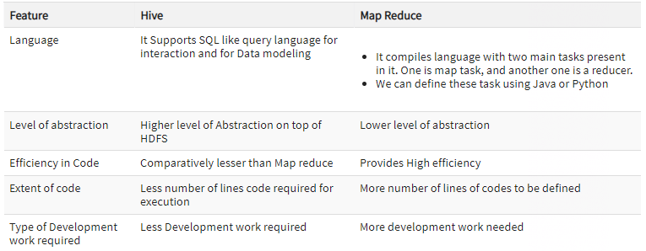
Hive Vs MapReduce

Slide 7
Important Characteristics of Hive
In Hive, tables and databases are created first and then data is loaded into these tables.
Hive as data warehouse designed for managing and querying only structured data that is stored in tables.
While dealing with structured data, Map Reduce doesn't have optimization and usability features like UDFs but Hive framework does. Query optimization refers to an effective way of query execution in terms of performance.
Hive's SQL-inspired language separates the user from the complexity of Map Reduce programming. It reuses familiar concepts from the relational database world, such as tables, rows, columns and schema, etc. for ease of learning.

Slide 8
Hadoop's programming works on flat files. So, Hive can use directory structures to "partition" data to improve performance on certain queries.
Generally, HQL syntax is similar to the SQL syntax that most data analysts are familiar with. The Sample query below display all the records present in mentioned table name.
Sample query : Select * from <TableName>
Hive supports four file formats those are TEXTFILE, SEQUENCEFILE, ORC and RCFILE.
For single user metadata storage, Hive uses derby database and for multiple user Metadata or shared Metadata case Hive uses MYSQL.

Slide 9
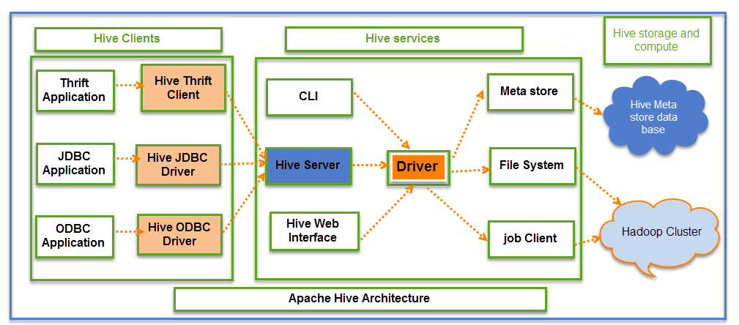
APACHE HIVE ARCHITECTURE

Slide 10
Hive Consists of Mainly 3 core parts
Hive Clients
Hive Services
Hive Storage and Computing
Hive Clients:
Hive provides different drivers for communication with a different type of applications.
For Thrift based applications, it will provide Thrift client for communication.

Slide 11
For Java related applications, it provides JDBC Drivers. Other than any type of applications provided ODBC drivers. These Clients and drivers in turn again communicate with Hive server in the Hive services.
Hive Services:
Client interactions with Hive can be performed through Hive Services. If the client wants to perform any query related operations in Hive, it has to communicate through Hive Services.
Driver present in the Hive services represents the main driver, and it communicates all type of JDBC, ODBC, and other client specific applications. Driver will process those requests from different applications to meta store and field systems for further processing.

Slide 12
CLI is the command line interface acts as Hive service for DDL (Data definition Language) operations. All drivers communicate with Hive server and to the main driver in Hive services as shown in above architecture diagram.
Hive Storage and Computing:
Hive services such as Meta store, File system, and Job Client in turn communicates with Hive storage and performs the following actions
Metadata information of tables created in Hive is stored in Hive "Meta storage database".
Query results and data loaded in the tables are going to be stored in Hadoop cluster on HDFS.

Slide 13
Setting the Environment
The following softwares are required
• Apache Hadoop
• Apache Hive
• Java 7

Slide 14

First, create a directory ( /cdh , for example) and set its permissions to global ( 777 ).
Download and install the Java 7 tar file.
Download the CDH 5.4.7 Hadoop 2.6.0 tar file and extract the file to the /cdh directory.

Slide 15
Create symlinks for the Hadoop bin and conf directories. Symlinks are required because the CDH distributions can vary slightly with version and some directory and file references are preconfigured. For example, the configuration directory is expected to be $HADOOP_HOME/conf and the directory with the runnable scripts is expected to be $HADOOP_HOME/bin
Download and extract the Apache Hive tar file .

Slide 16
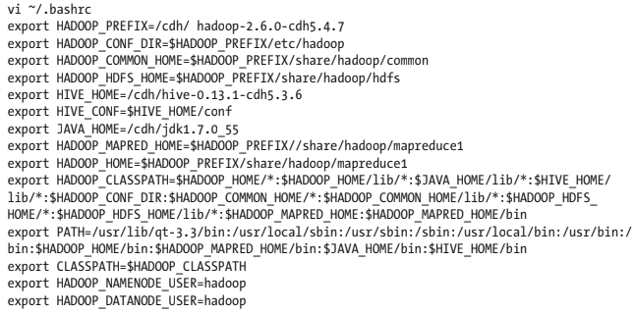
Set the following environment variables for Hadoop, Hive, and Java in the bash shell. This section installed Apache Hadoop and Apache Hive and set the environment variables .

Slide 17
Hive Queries
Using Apache Hive queries, you can query distributed data storage including Hadoop data.
Hive supports ANSI SQL and atomic, consistent, isolated, and durable (ACID) transactions. For updating data, you can use the MERGE statement, which now also meets ACID standards. Materialized views optimize queries based on access patterns. Hive supports tables up to 300PB in Optimized Row Columnar (ORC) format. Other file formats are also supported.
You can create tables that resemble those in a traditional relational database.

Slide 18
You use familiar insert, update, delete, and merge SQL statements to query table data.
The insert statement writes data to tables. Update and delete statements modify and delete values already written to Hive. The merge statement streamlines updates, deletes, and changes data capture operations by drawing on co-existing tables.
These statements support auto-commit that treats each statement as a separate transaction and commits it after the SQL statement is executed.

Slide 19
Simple Selects – Selecting columns
In Hive, querying data is performed by a SELECT statement. A select statement has 6 key components;
SELECT column names
FROM table-name
GROUP BY column names
WHERE conditions
HAVING conditions
ORDER by column names

Slide 20
In practice, very few queries will have all of these clauses in them simplifying many queries. On the other hand, conditions in the WHERE clause can be very complex and if you need to JOIN two or more tables together then more clauses (JOIN and ON) are needed.
HQL is not case sensitive.
Neither do you need to write each clause on a new line, but it is often clearer to do so for all but the simplest of queries.

Slide 21
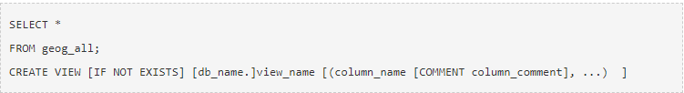

Amongst all the hive queries, the simplest query is effectively one which returns the contents of the whole table.
It is more efficient to explicitly list the column names that you want to be returned.

Slide 22
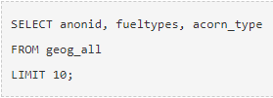

Simple Selects – Selecting rows
In addition to limiting the columns returned by a query, you can also limit the rows returned. The simplest case is to say how many rows are wanted using the Limit clause.
This is useful if you just want to get a feel for what the data looks like. Usually, you will want to restrict the rows returned based on some criteria. i.e. certain values or ranges within one or more columns.

Slide 23
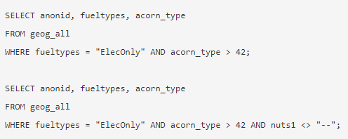
The Expression in the where clause can be more complex and involve more than one column.

Slide 24
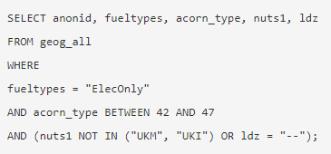
Notice that the columns used in the conditions of the Where clause don’t have to appear in the Select clause. Other operators can also be used in the where clause. For complex expressions, brackets can be used to enforce precedence.

Slide 25

Creating New Columns
It is possible to create new columns in the output of the query. These columns can be from combinations from the other columns using operators and/or built-in Hive functions.
When you create a new column it is usual to provide an ‘alias’ for the column.

Slide 26
This is essentially the name you wish to give to the new column.
The alias is given immediately after the expression to which it refers. Optionally you can add the AS keyword for clarity.
If you do not provide an alias for your new columns, Hive will generate a name for you.
Although the term alias may seem a bit odd for a new column that has no natural name, alias’ can also be used with any existing column to provide a more meaningful name in the output.
Tables can also be given an alias, this is particularly common in join queries involving multiple tables where there is a need to distinguish between columns with the same name in different tables. In addition to using operators to create new columns, there are also many Hive built‐in functions that can be used.

Slide 27
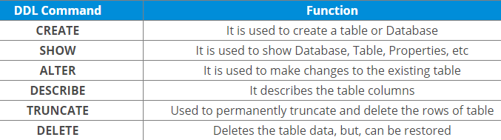
Hive Commands
Data Definition Language (DDL )
DDL statements are used to build and modify the tables and other objects in the database.

Slide 28


Go to Hive shell by giving the command sudo hive and enter the command ‘create database<data base name>’ to create the new database in the Hive.
To list out the databases in Hive warehouse, enter the command ‘show databases’.

Slide 29
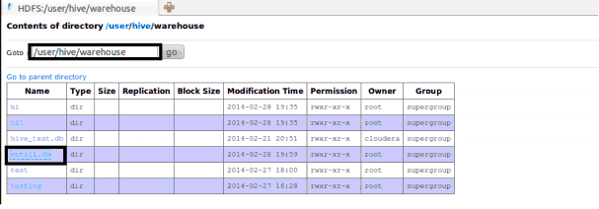
The database creates in a default location of the Hive warehouse. In Cloudera, Hive database store in a /user/hive/warehouse.

Slide 30

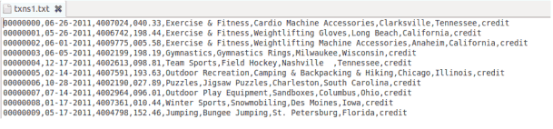
The command to use the database is USE <data base name>
Copy the input data to HDFS from local by using the copy From Local command.

Slide 31

When we create a table in hive, it creates in the default location of the hive warehouse. – “/user/hive/warehouse”, after creation of the table we can move the data from HDFS to hive table.
The following command creates a table with in location of “/user/hive/warehouse/retail.db”. retail.db is the database created in the Hive warehouse.

Slide 32
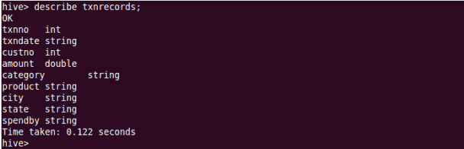
Describe provides information about the schema of the table.

Slide 33
Data Manipulation Language (DML )
DML statements are used to retrieve, store, modify, delete, insert and update data in the database.
Example :
LOAD, INSERT Statements.
Syntax :
LOAD data <LOCAL> inpath <file path> into table [tablename]

Slide 34

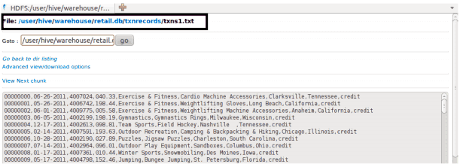
The Load operation is used to move the data into corresponding Hive table. If the keyword local is specified, then in the load command will give the local file system path. If the keyword local is not specified we have to use the HDFS path of the file.

Slide 35
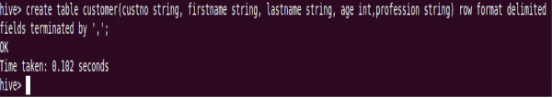
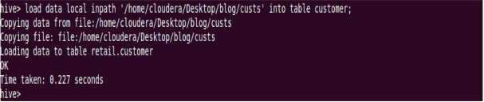
Here are some examples for the LOAD data LOCAL command.
After loading the data into the Hive table we can apply the Data Manipulation Statements or aggregate functions retrieve the data.

Slide 36
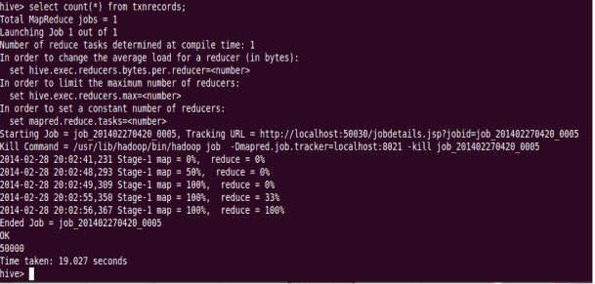
Example to count number of records: Count aggregate function is used count the total number of the records in a table.

Slide 37

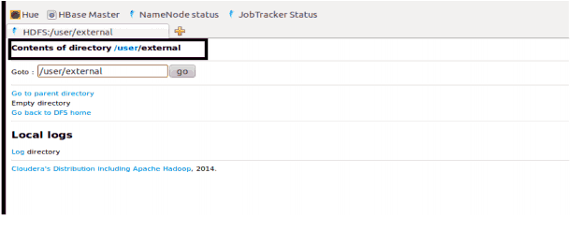
‘create external’ Table : The create external keyword is used to create a table and provides a location where the table will create, so that Hive does not use a default location for this table.
An EXTERNAL table points to any HDFS location for its storage, rather than default storage.

Slide 38
Insert Command
The insert command is used to load the data Hive table.
Inserts can be done to a table or a partition.
INSERT OVERWRITE is used to overwrite the existing data in the table or partition.
INSERT INTO is used to append the data into existing data in a table.

Slide 39
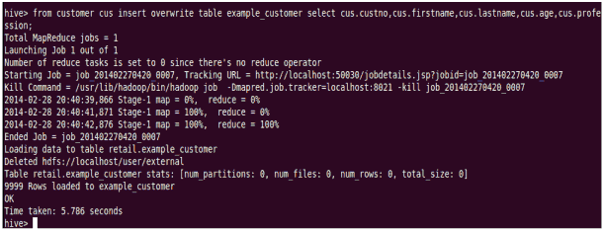
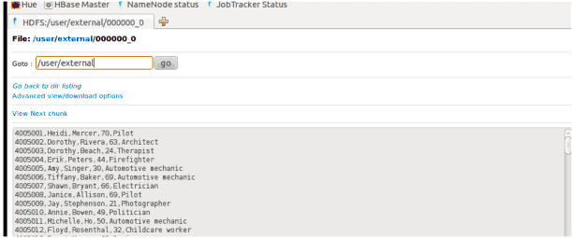

Slide 40
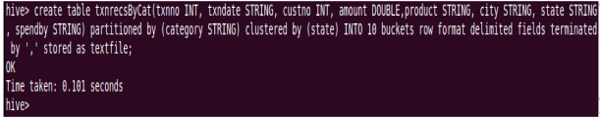

Example for ‘Partitioned By’ and ‘Clustered By’ Command
‘Partitioned by‘ is used to divided the table into the Partition and can be divided into buckets by using the ‘Clustered By‘ command.

Slide 41
When we insert the data Hive throwing errors, the dynamic partition mode is strict and dynamic partition not enabled. So we need to set the following parameters in Hive shell.
set hive.exec.dynamic.partition=true;
To enable dynamic partitions, by default, it’s false
set hive.exec.dynamic.partition.mode=nonstrict;

Slide 42
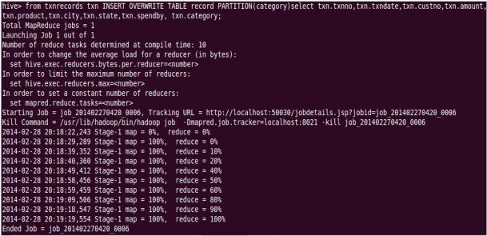
Partition is done by the category and can be divided in to buckets by using the ‘Clustered By’ command.

Slide 43
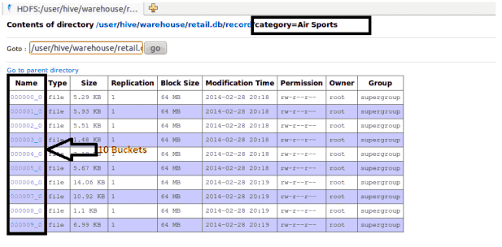

Slide 44

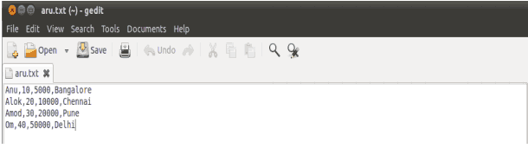
The ‘Drop Table’ statement deletes the data and metadata for a table. In the case of external tables, only the metadata is deleted.

Slide 45
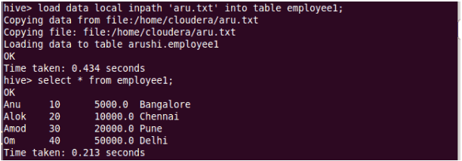
The ‘Drop Table’ statement deletes the data and metadata for a table. In the case of external tables, only the metadata is deleted.
Load data local inpath ‘aru.txt’ into table tablename and then we check employee1 table by using Select * from table name command.

Slide 46
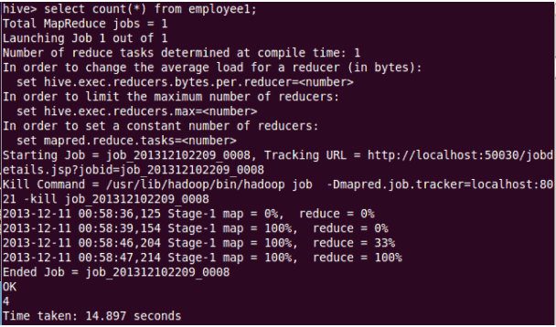
To count the number of records in table by using Select count(*) from txnrecords;

Slide 47
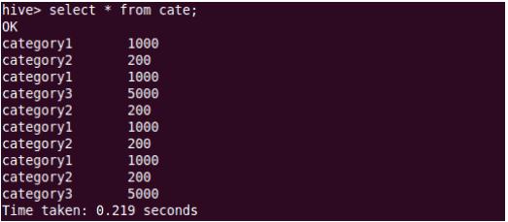
Aggregation
Select count (DISTINCT category) from tablename;
This command will count the different category of ‘cate’ table. Here there are 3 different categories.
Suppose there is another table cate where f1 is field name of category.

Slide 48
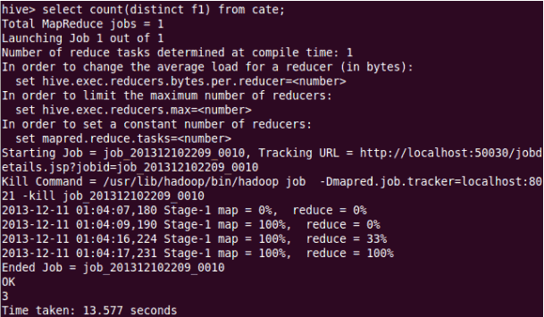

Slide 49
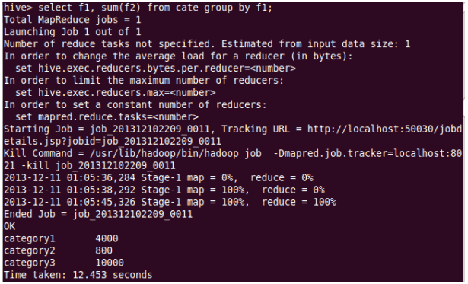
Grouping
Group command is used to group the result-set by one or more columns.
Select category, sum( amount) from txt records group by category
It calculates the amount of same category.

Slide 50
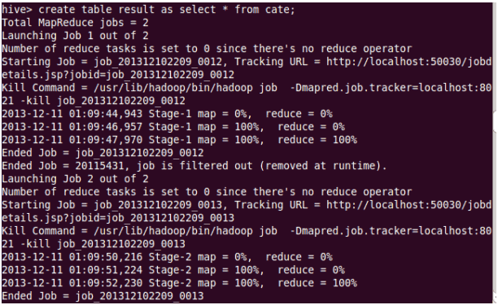
The result one table is stored in to another table.
Create table newtablename as select * from oldtablename;

Slide 51


Join Command
Here one more table is created in the name ‘mailid’

Slide 52
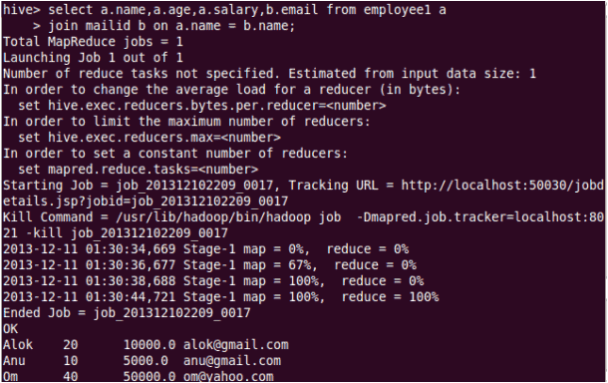
Join Operation
A Join operation is performed to combining fields from two tables by using values common to each.

Slide 53
Left Outer Join
The result of a left outer join (or simply left join) for tables A and B always contains all records of the “left” table (A), even if the join-condition does not find any matching record in the “right” table (B).

Slide 54
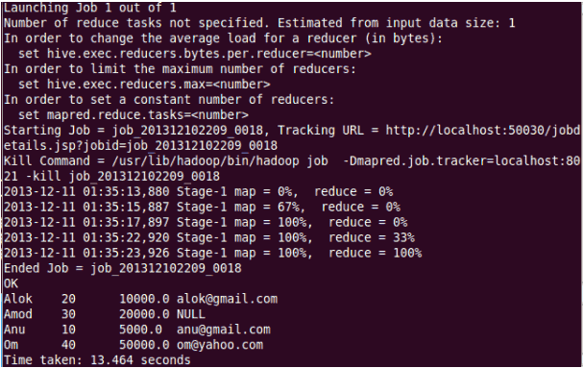

Slide 55
Right Outer Join
A right outer join (or right join) closely resembles a left outer join, except with the treatment of the tables reversed.
Every row from the “right” table (B) will appear in the joined table at least once.

Slide 56
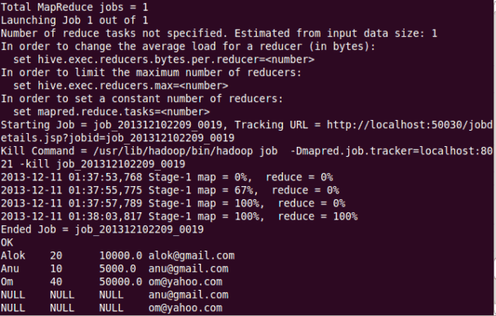

Slide 57
Full Join
The joined table will contain all records from both tables, and fill in NULLs for missing matches on either side.

Slide 58
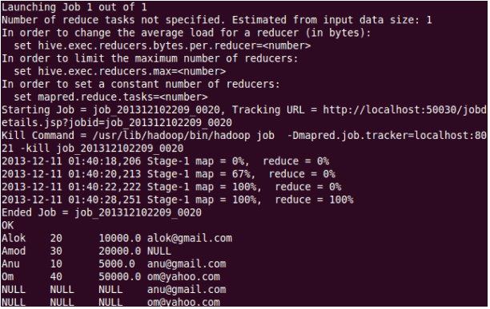
Once done with hive we can use quit command to exit from the hive shell.

Slide 59
END OF SESSION
Q & A

